Slide 1
.NET Framework
By: Brandon Martinez

Slide 2
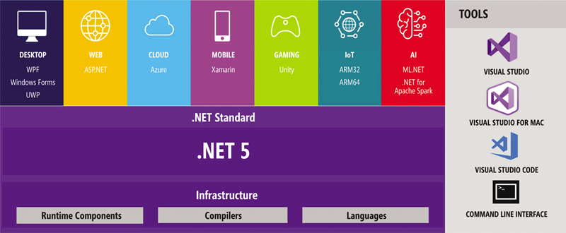
History and Use
Early developed in 1990s by Microsoft
Library of code for basic program operations
Ecosystem of languages, runtimes, and libraries
No need to write code to run programs
Used for running or building apps

Slide 3
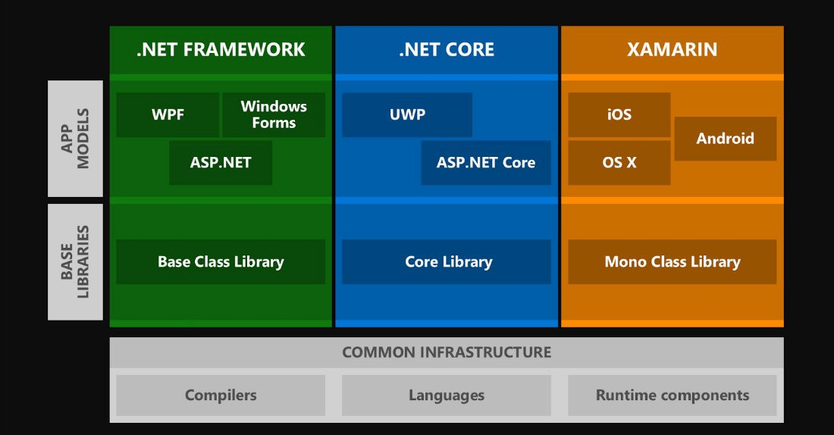
WPF- Windows Presentation Foundation - framework for UI development
Windows Forms - graphical class library
ASP.NET - app framework for web development

Slide 4
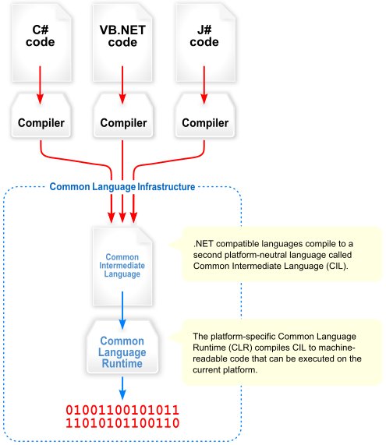
Infrastructure
(discontinued)
Common Language Infrastructure (CLI)
Languages
C#, F#, VB, and others
Library
Framework Class Library (FCL)
Base Class Library (BCL)
Runtimes
Common Language Runtime (CLR)
Includes Just-in-time compiler (JIT)
Common Language Specifications for CIL
System of rules for .NET languages

Slide 5
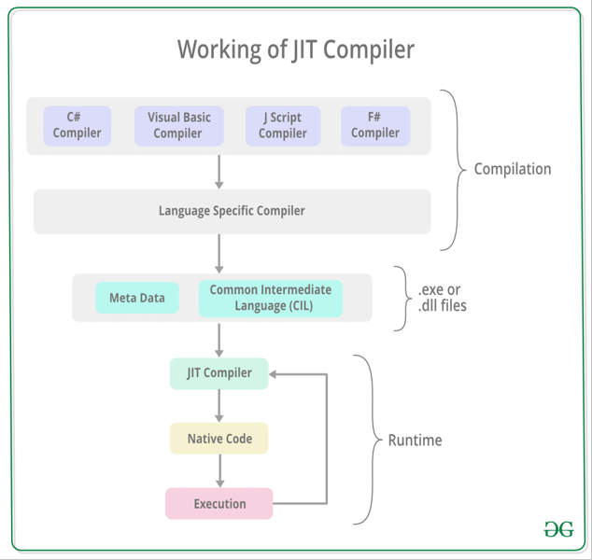
Programming
Runtimes are execution engines
CLR serves as memory management, type safety, exception handling, and more
Runs C++ code in both Visual C++ and CLR runtimes
Translates some parts into CIL for CLR
Common Intermediate Language is compiled into CLI assemblies
Stored as PE format for Windows DLL and EXE files
CLR is the app VM

Slide 6
Demonstration

Slide 7
References
https://stackoverflow.com/questions/7772798/f-and-j-are-they-same
https://en.wikipedia.org/wiki/.NET_Framework
https://dotnet.microsoft.com/learn/aspnet/hello-world-tutorial/modify
https://docs.microsoft.com/en-us/dotnet/desktop/wpf/get-started/create-app-visual-studio?view=netdesktop-5.0

